Slide 1
Sterling BEST SEALED® Insulated HVAC Register Boxes
Sterling Custom Sheet Metal http://www.sterlingcustomsheetmetal.com
US Patent Nos. US 10,309,682 B2/US 10,648,695 B2/US 9,951,969 B2

Slide 2
HVAC DUCT SEALING IS VERY IMPORTANT!
%
In a typical house about 20% of the air that moves through the duct systems is lost due to leaks, holes, and poorly connected ducts.
Source:
BENEFITS OF IMPROVED HVAC DUCTING:
COMFORT AIR QUALITY SAVE MONEY ENVIRONMENT
Stuffy rooms? Rooms too hot or too cold? You probably have leaking ducts!
Allergies? Asthma? Sealed ducts reduce the introduction of pollutants into your home!
High energy bills?
Leaking ducts significantly reduce the efficiency of your HVAC system
Reducing energy consumption at home reduces power plant emissions and helps to fight global warming!
Sterling Custom Sheet Metal http://www.sterlingcustomsheetmetal.com

Slide 3
HVAC DUCT SEALING SAVES HOMEOWNERS MONEY!
$
The amount of money that a homeowner could be saving in energy bills with properly sealed and insulated HVAC ducting.
Source: Pacific Northwest National Laboratory/U.S. Department of Energy Study
<2 YEAR
A California Energy Commission study showed that the average cost of improving duct sealing and upgrading to R-8 insulation on your HVAC system is
approximately $500.
RETURN ON INVESTMENT
Sterling Custom Sheet Metal http://www.sterlingcustomsheetmetal.com

Slide 4
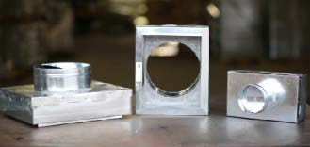
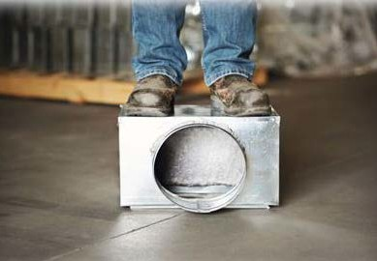
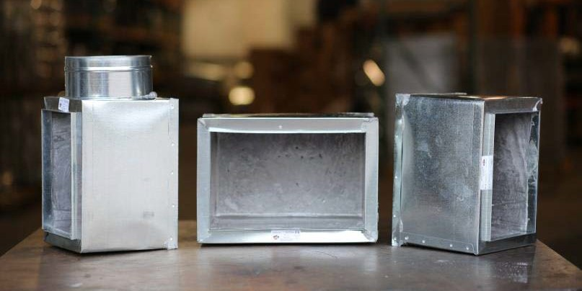
Sterling BEST SEALED ® Register Box checks ALL the Boxes!
ENERGY SAVING
FIBER FREE
CODE APPROVED
SAVES MONEY
Rigid PUR Insulation creates an airtight box and can be configured to provide R-6 or R-8 insulation.
Elimination of fiberglass insulation from the airstream improves air quality.
Meets building code requirements for flame spread, smoke development and thermal insulation.
Patented design reduces installation cost and saves the homeowner on energy costs.
US Patent Nos. US 10,309,682 B2/US 10,648,695 B2/US 9,951,969 B2
Sterling Custom Sheet Metal http://www.sterlingcustomsheetmetal.com

Slide 5
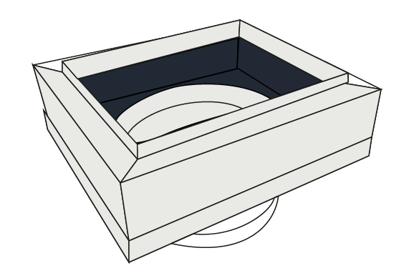
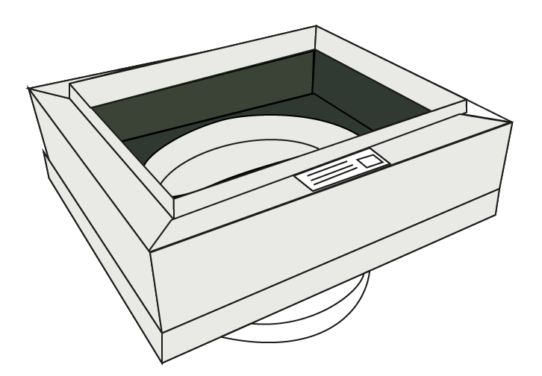
Sterling BEST SEALED ® Register Box :
Key Features that Pros Love and Make a Difference
TYPICAL INSULATED REGISTER BOXES TODAY
Sterling Best Sealed IMPROVED INSULATED REGISTER BOXES
FIBERGLASS
ROBUST BOX
RIGID
INSULATION
CONSTRUCTION
POLYURETHANE
THAT WILL NOT
FOAM INSULATION
DAMAGE EASILY
SEAMS MUST
BOX EASILY
POLYURETHANE
BE SEALED
DAMAGED IN
FOAM FLOWS INTO
BUILDING CODE
WITH MASTIC
TRANSIT
SEAMS CREATING
APPROVAL IN R-6 &
AIRTIGHT SEAL
R-8 CONFIGURATIONS
US Patent Nos. US 10,309,682 B2/US 10,648,695 B2/US 9,951,969 B2
Sterling Custom Sheet Metal http://www.sterlingcustomsheetmetal.com

Slide 6
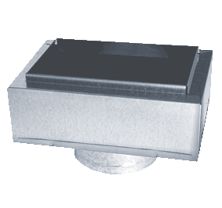
Sterling BEST SEALED ® Register Box Features
LENGTH (L) | WIDTH (W) | COLLAR DIAMETERS AVAILABLE
 |  | 4 in | 5in | 6in | 7in | 8in | 9in | 10in
8in | 4in | x | x
10in | 6in | x | x | x
10in | 8in | x | x | x | x | x | x
10in | 10in | x | x | x | x | x | x
12in | 6in | x | x | x | x
14in | 8in | x | x | x | x | x | x
12in | 12in | x | x | x | x | x | x | x
14in | 8in | x | x | x | x | x | x
L
W
Key features:
Building code approved for Type V Construction per IAPMO UES ER-0448
ER-0448
Pre-insulated and sealed – no need to wrap with fiberglass or apply mastic to box seams
Boxes come configured with either R-6 or R-8 insulation
Insulation is fiber-free!
Made of zinc-coated 30GA galvanized steel
Also available with no collars or with side mounted collars
Patented box design has pre-punched nail holes on inner flange for easier install
Robust construction that prevents damage in shipment or during installation process
US Patent Nos. US 10,309,682 B2/US 10,648,695 B2/US 9,951,969 B2
Sterling Custom Sheet Metal http://www.sterlingcustomsheetmetal.com

Slide 7
Sterling BEST SEALED ® Register Box
DO NOT build your home without it!
Contractor/Installer; Ask your Local Distributor for the Sterling BEST SEALED ® Register Box, avoid leaks and pass the inspection the first time.
Home Builder; Build a better, more energy efficient home using the Sterling BEST SEALED ® Register Box
Homeowner; Demand the Sterling BEST SEALED ® Register Box in your home for years of reliable, leak-free, efficient cooling.
For Inquiries contact:
Sterling Custom Sheet Metal
(281) 356-2388
Info@SterlingCustomSheetMetal.com
US Patent Nos. US 10,309,682 B2/US 10,648,695 B2/US 9,951,969 B2
Sterling Custom Sheet Metal http://www.sterlingcustomsheetmetal.com

